Slide 1

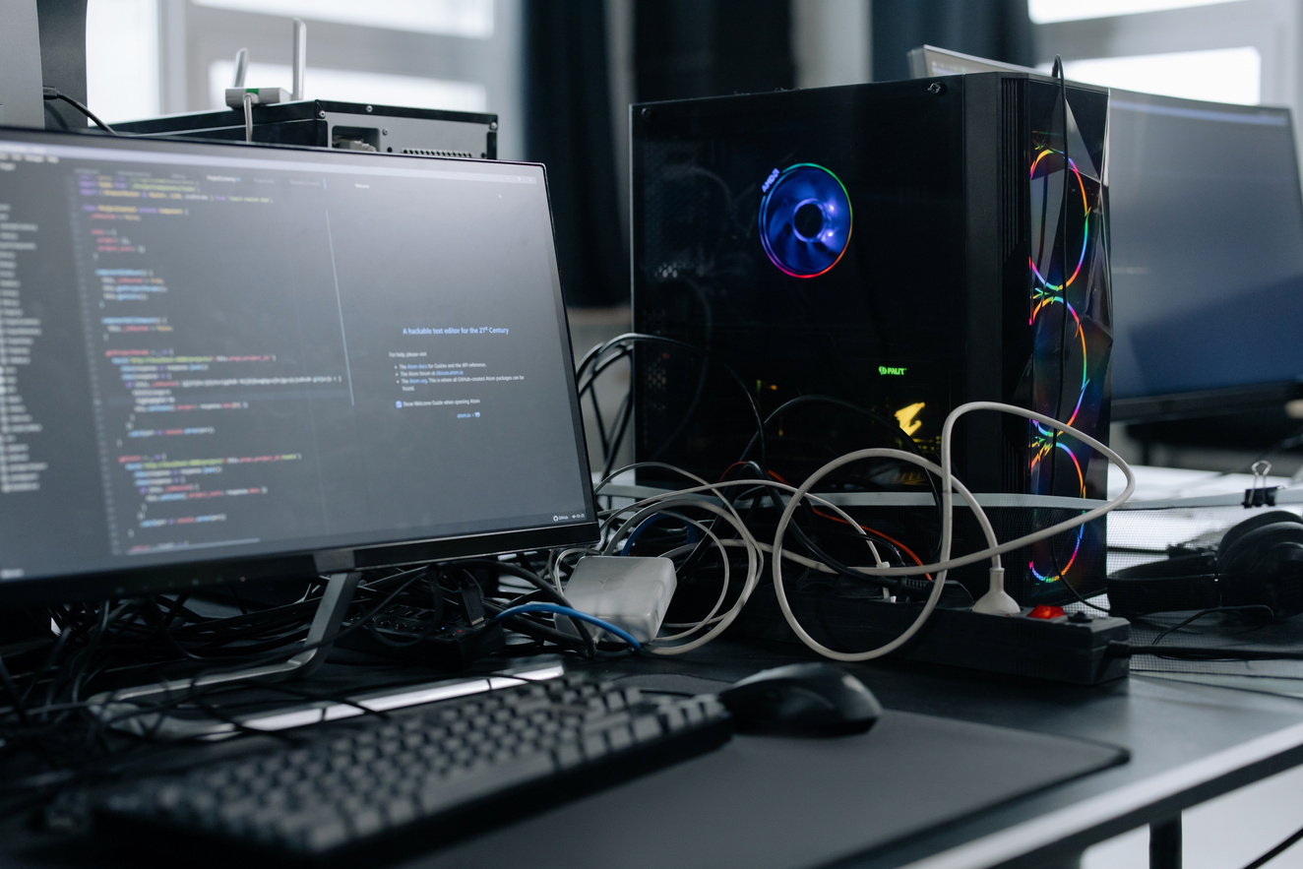
Studio Shodwe
Home
About
Contact
NAME : P.SRIDHARSHINI
REG NO : 2428A0026
NMID : asbru262428a0026
DEPARTMENT : B.SC. DIGITAL ANDCYBRE FORENSIC SCIENCE
COLLEGE : SHRI NEHRU MAHA VIDYALAYA COLLEGE OF ARTS AND SCIENCE
Get Started
2025 Presentation

Slide 2

About
Contact
PERSONAL PORTFOLIO
WEBSITE
2025 Presentation

Slide 3

Studio Shodwe
Home
About
Contact
AGENDA
•PROBLEM STATEMENT
•PROJECT OVERVIEW
•END USERS
•TOOLS AND TECHNOLOGIES
•PORTFOLIO DESIGN AND LAYOUT
•FEATURES AND FUNCTIONALITY
•RESULTS AND SCREENSHOTS
•CONCLUSION
GITHUB LINK
Learn More
2025 Presentation

Slide 4

Studio Shodwe
Home
About
Contact
PROBLEM STATEMENT
IN THE MODERN DIGITAL ERA, RELYING ONLY ON TRADITIONAL
RESUMES IS NOT ENOUGH TO SHOWCASE AN INDIVIDUAL’S
SKILLS, PROJECTS, AND ACHIEVEMENTS. RECRUITERS AND
COLLABORATORS OFTEN LOOK FOR AN ONLINE PRESENCE
THAT REFLECTS BOTH TECHNICAL EXPERTISE AND
CREATIVITY. WITHOUT A PERSONAL DIGITAL SPACE, IT
BECOMES DIFFICULT TO STAND OUT IN A COMPETITIVE
FIELD. TO OVERCOME THIS CHALLENGE, THIS PROJECT
FOCUSES ON DEVELOPING A PERSONAL PORTFOLIO
WEBSITE , PROVIDING AN ORGANIZED AND PROFESSIONAL
PLATFORM TO PRESENT QUALIFICATIONS, CERTIFICATIONS,
AND PROJECTS IN AN EASILY ACCESSIBLE MANNER.

Slide 5

Studio Shodwe
Home
About
Contact
PROJECT OVERVIEW
THE PERSONAL PORTFOLIO WEBSITE IS DEVELOPED FOR ALMAS
BEGAM TO BUILD A STRONG ONLINE PRESENCE AND SHOWCASE
ACADEMIC QUALIFICATIONS, TECHNICAL SKILLS, CERTIFICATIONS, AND
PROJECTS. IT ACTS AS A DIGITAL RESUME THAT IS EASILY ACCESSIBLE
AND HELPS RECRUITERS AND COLLABORATORS UNDERSTAND
PROFESSIONAL ABILITIES AT A GLANCE. DESIGNED WITH A
RESPONSIVE LAYOUT, THE PORTFOLIO ENSURES SMOOTH VIEWING
ACROSS DEVICES WHILE PRESENTING INFORMATION IN A CLEAR AND
ORGANIZED MANNER.
2025 Presentation

Slide 6

Studio Shodwe
Home
END USERS
RECRUITERS AND
EMPLOYERS – TO
EVALUATE SKILLS,
QUALIFICATIONS, AND
PROJECTS FOR JOB
OPPORTUNITIES.
GENERAL AUDIENCE –
ANYONE INTERESTED IN
LEARNING MORE ABOUT
THE PROFESSIONAL PROFILE
OF ALMAS BEGAM.
PEERS AND
COLLABORATORS – TO
CONNECT FOR ACADEMIC
OR PROFESSIONAL
PROJECTS.
FACULTY MEMBERS AND
EVALUATORS – TO ASSESS
TECHNICAL KNOWLEDGE
AND PROJECT WORK.

Slide 7
Studio Shodwe
Home
About
Contact
TOOLS AND TECHNIQUES
FRONTEND DEVELOPMENT:
HTML5 – FOR STRUCTURING THE WEB PAGES.
CSS3 – FOR STYLING AND LAYOUT DESIGN.
JAVASCRIPT – FOR INTERACTIVITY AND DYNAMIC BEHAVIOR.
VERSION CONTROL & HOSTING:
GIT & GITHUB – FOR VERSION CONTROL AND PROJECT HOSTING.
DESIGN TOOLS:
CANVA / FIGMA – FOR CREATING AND REFINING UI/UX DESIGNS.
TECHNIQUES:
RESPONSIVE WEB DESIGN – ENSURING COMPATIBILITY ACROSS DEVICES.
USER-CENTERED DESIGN – FOCUSING ON READABILITY, ACCESSIBILITY, AND PROFESSIONAL
PRESENTATION.
CODE OPTIMIZATION – CLEAN, REUSABLE, AND WELL-STRUCTURED CODE FOR PERFORMANCE
2025 Presentation

Slide 8

Studio Shodwe
Home
About
Contact
PORTFOLIO DESIGN AND LAYOUT
HOME PAGE – A BRIEF INTRODUCTION WITH NAME, TITLE, AND A PROFESSIONAL
TAGLINE.
ABOUT ME – SHOWCASING PERSONAL BACKGROUND, EDUCATION, AND CAREER
GOALS.
SKILLS – HIGHLIGHTING TECHNICAL AND SOFT SKILLS IN AN ORGANIZED FORMAT.
PROJECTS – DISPLAYING ACADEMIC AND PERSONAL PROJECTS WITH
DESCRIPTIONS.
CERTIFICATIONS – LISTING RELEVANT CERTIFICATIONS AND ACHIEVEMENTS.
CONTACT SECTION – PROVIDING EMAIL, PHONE, AND SOCIAL MEDIA LINKS FOR
EASY COMMUNICATION.
THE PORTFOLIO WEBSITE IS DESIGNED WITH A
CLEAN AND MODERN LAYOUT TO ENSURE
PROFESSIONALISM AND USER-FRIENDLY
NAVIGATION. THE DESIGN FOLLOWS A
RESPONSIVE WEB STRUCTURE, MAKING IT
ACCESSIBLE ACROSS DESKTOPS, TABLETS,
AND MOBILE DEVICES.
2025 Presentation

Slide 9

Studio Shodwe
Home
About
Contact
FEATURES AND FUNCTIONALITIES
•RESPONSIVE DESIGN – WORKS SMOOTHLY ON DESKTOP, TABLET, AND MOBILE.
•HOME & ABOUT SECTIONS – INTRODUCTION, BACKGROUND, AND CAREER GOALS.
•SKILLS & PROJECTS – SHOWCASES TECHNICAL ABILITIES AND ACADEMIC WORK.
•CERTIFICATIONS – DISPLAYS COMPLETED CERTIFICATIONS AND ACHIEVEMENTS.
•CONTACT SECTION – PROVIDES EMAIL, PHONE, AND SOCIAL MEDIA LINKS.
EASY NAVIGATION – CLEAN AND USER-FRIENDLY MENU SYSTEM.
2025 Presentation

Slide 10

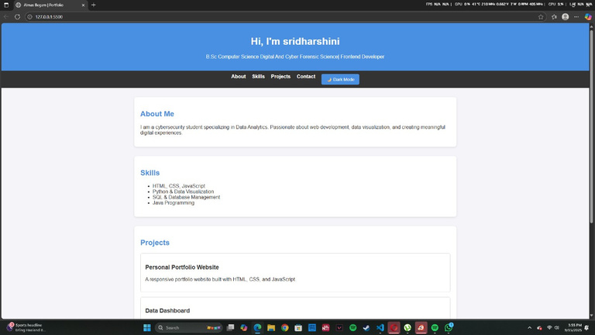
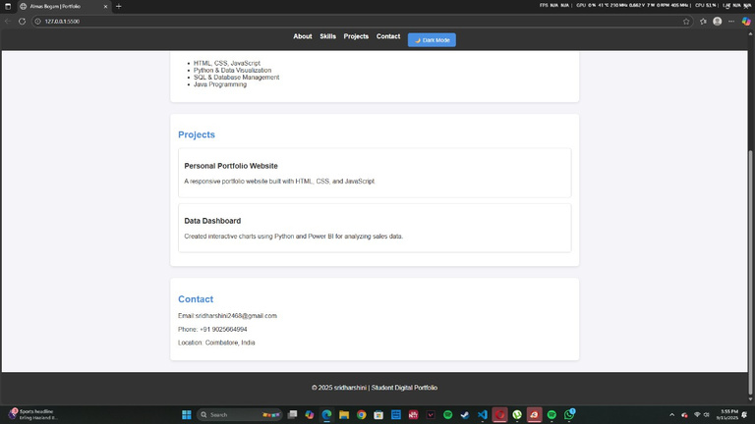
Studio Shodwe
Home
About
Contact
RESULTS AND SCREENSHOTS
THE PORTFOLIO WEBSITE EFFECTIVELY HIGHLIGHTS MY SKILLS, EDUCATION, PROJECTS, AND
ACHIEVEMENTS IN A STRUCTURED MANNER. IT PROVIDES RECRUITERS AND PEERS WITH EASY
ACCESS TO MY PROFESSIONAL DETAILS, IMPROVING VISIBILITY AND NETWORKING OPPORTUNITIES.
THE RESPONSIVE DESIGN ENSURES A SMOOTH VIEWING EXPERIENCE ACROSS DEVICES, MAKING
THE PORTFOLIO BOTH PRACTICAL AND IMPACTFUL.

Slide 11

Studio Shodwe
Home
About
Contact
CONCLUSION
THE PERSONAL PORTFOLIO WEBSITE SUCCESSFULLY
PROVIDES A PROFESSIONAL PLATFORM FOR ALMAS BEGAM
TO SHOWCASE ACADEMIC ACHIEVEMENTS, TECHNICAL
SKILLS, CERTIFICATIONS, AND PROJECTS IN AN ORGANIZED
MANNER. IT SERVES AS A DIGITAL RESUME, ENHANCING
VISIBILITY AND ACCESSIBILITY FOR RECRUITERS, PEERS, AND
COLLABORATORS. WITH ITS RESPONSIVE DESIGN AND USER-
FRIENDLY LAYOUT, THE PORTFOLIO STRENGTHENS PERSONAL
BRANDING AND SUPPORTS FUTURE CAREER OPPORTUNITIES.
2025 Presentation

Slide 12
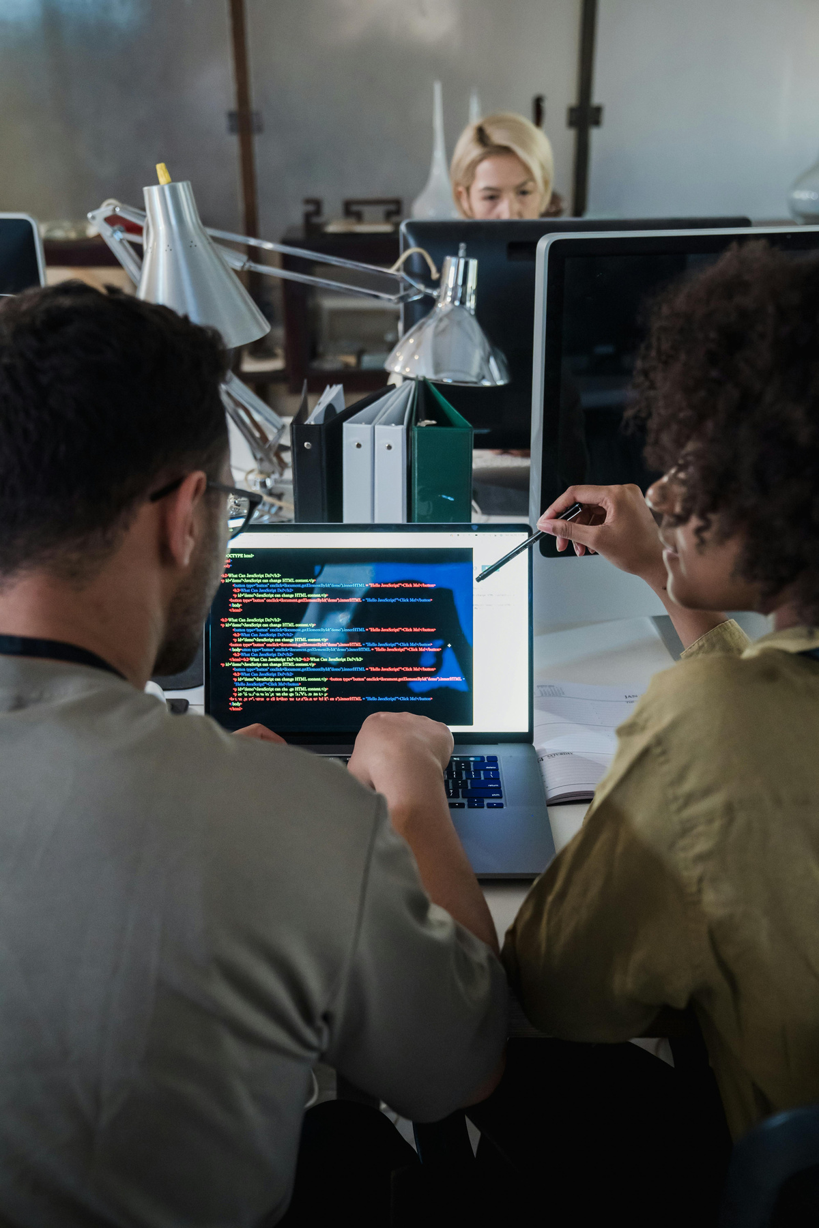


Studio Shodwe
Home
About
Contact
THANK YOU
Phone Number
Email
91+9025664994
sridharshini2468@gmail.com
SHRI NEHRU MAHA VIDYALAYA COLLEGE OF ARTS AND SCIENCE
THANK YOU FOR TAKING THE TIME TO VIEW MY PORTFOLIO.
I TRULY APPRECIATE YOUR ATTENTION AND SUPPORT.
LOOKING FORWARD TO YOUR FEEDBACK AND SUGGESTIONS!

